Slide 1

CS FYP weekly Presentation
Caleb Mok
2689719m
30/1/2025

Slide 2
What I had prior and currently trying to do
Had the testing scene drafted but the dot updating function was not randomized and it was just a working concept.
Trying to randomize the dot coordinates generation and figure out which data structure to save and export the user input
Getting the user input when the user detected the dots
Had few objectives planned due to deadline of physics report approaching.

Slide 3
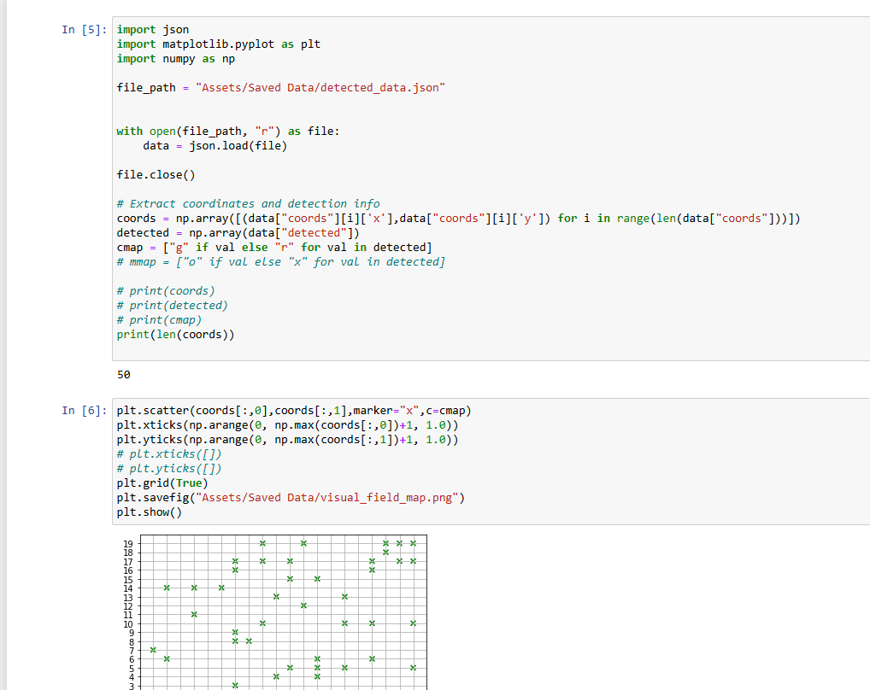
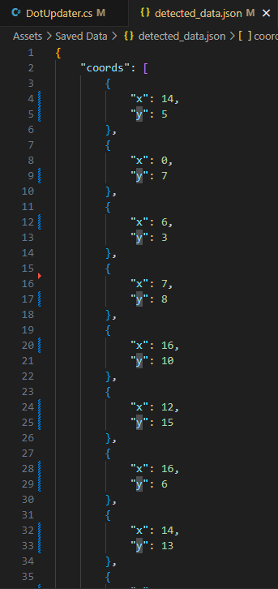
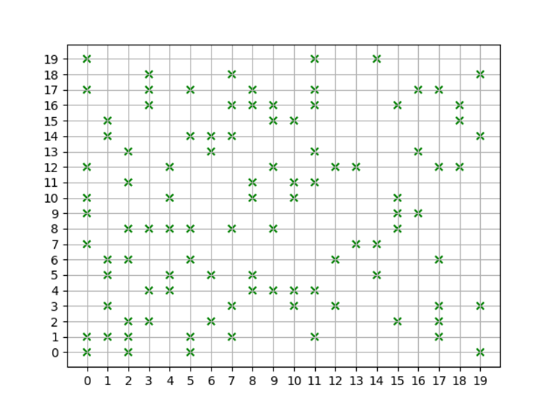
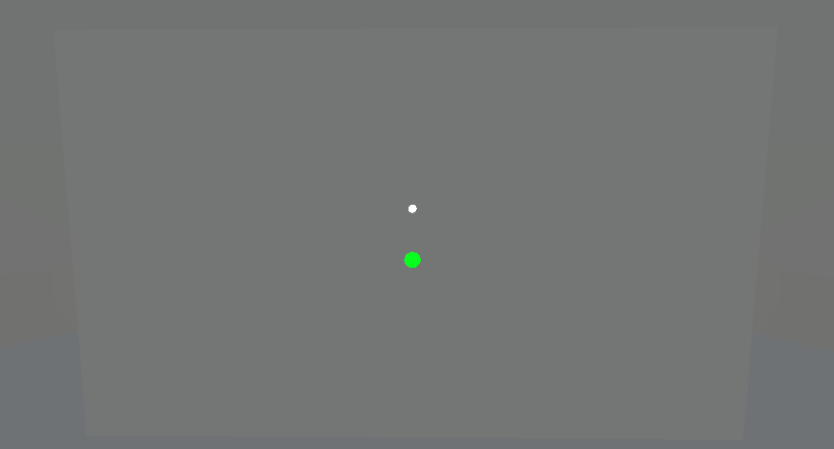
What I achieved this week
Dot flashing code working with user input detection working
Updated scene colour after brief testing as it was too straining on the eyes for prolonged test
Json data construction and exporting completed
Data visualization python script prototyped

Slide 4
What I plan to do next (1)
Add controller input instead of keyboard input
Limit camera such that it does not follow headset movement
Add tutorial section as slides into main scene
Finish up the scene transitions and miscellaneous functions such as About and Exit
Add test start countdown for user feedback
Tweak the python script of generating VFM and pdf report
- Include metrics such as invalid detections and gaze focus percentage + heatmap
Implement eye tracking for instant feedback to reduce fixation losses

Slide 5
What I plan to do next (2)
Update the dot generating logic such that it is precomputed and appear at the same rate
Update the dot to flash faster
Update such that the dot shows up more frequently at places where the user didn’t detect it
Test user relaxation time
Add audio cues + testing whether it helps with detection
Add familiarization test before actual test

